Slide 1

Unit - 6 Entity Relationship (ER) Model
Dr. Asif Sohail University of the Punjab
Department of Information Technology, FCIT

Slide 2
Outline
Introduction
Basic Constructs and Notations
Connectivity / Cardinality of a Relationship
Degree of a Relationship
Existence Dependency (Identifying Relationship)
Associative Entity
Modeling Multivalued Attribute
Time dependent data

Slide 3
Entity Relationship (ER) Model
It is the mainstream approach for conceptual data modeling.
It expresses logical representation for an organization in terms of Entities, Relationships among Entities and Attributes of Entities and Relationship.
It is most often used as a communication tool between database designers and end users during analysis phase of database development.
It was proposed by Peter Chen in 1976.
The model has been subsequently extended in 1986 and 1991.
An ER model is normally expressed as an entity-relationship diagram (ERD).
The basic constructs of ER Model are:

Slide 4
ER Model – Basic Constructs
Entity
Relationship
Attribute
Multi valued
Associative
Entity
Strong
Strong
Weak
Associative
Entity

Slide 5
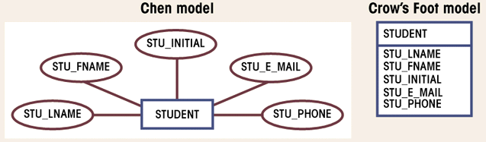
ER Model – Notations
ENTITY NAME
Identifier Attribute [Derived] {Multivalued} Composite( , , )

Slide 6
Sample ERD

Slide 7
Sample ERD

Slide 8
Naming Entity Type
Use capital letter for names of entity types.
An entity name
Is a singular noun e.g. CUSTOMER
Should be specific to the organization e.g. CUSTOMER, CLIENT
Should be concise, using as few words as possible e.g. REGISTRATION is better than STUDENT REGISTRATION FOR CLASS
Should be same for all E-R diagrams on which the same entity type appears
An attribute should be descriptive of the data represented by that attribute.
It is a good practice to prefix the entity name (or its abbreviation) with the attribute name. For example, CUST_ADDRESS.

Slide 9
E-R Model
Relationship
A relationship is any association, linkage, or connection between the entities of interest to the business; it is a bi-directional, significant association between entities, or between an entity and itself.
Relationship is a glue that holds the entities together.
Entities enrolled in a relationship are called its participants.
An example of a relationship would be:
Employees are assigned to projects
Projects have subtasks
Departments manage one or more projects

Slide 10
E-R Model
Relationship
The association, (aka connectivity or multiplicity) between the entity instances can be:
One to One (1:1)
One to Many (1:M)
Many to One (M:1)
Many to Many (M:N)
To identify the type of association or connectivity between entity A and entity B, ask yourself the following two questions:
How many instances of B are related to each instance of A?
How many instances of A are related to each instance of B?

Slide 11
E-R Model
Cardinality of a Relationship
It refers to the number of entity instances of one entity type that can be associated with the number of entity instances of the other entity or same entity type.
It assigns a specific value to connectivity.
There are two types of cardinality:
a) Minimum Cardinality
b) Maximum Cardinality (Cardinality Ratio)
Cardinality of relationship is expressed as:
(min-card, max-card)
Min/Max cardinalities refer to the Min/Max number of entity instances of one entity type that can be associated with the number of entity instances of the other entity or same entity type.

Slide 12
Cardinality of a Relationship

Slide 13
Relationship Participation
Participation of an entity instance in a relationship can be of two types:
1. Mandatory or Total Participation (Min Card=1,2,3,… ):
Every instance of an entity type must participate in a relationship (represented using double line).
2. Optional or Partial Participation (Min Card=0): Some instance of an entity type may not participate in a relationship

Slide 14
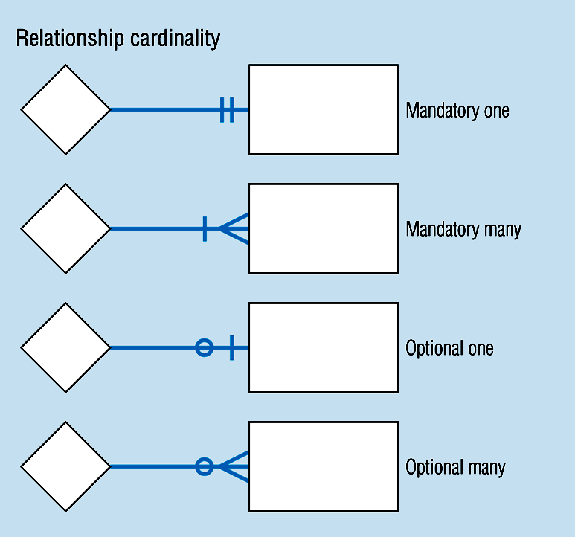
Relationship Participation
The combination of minimum and maximum cardinality generates the following combinations:
a) Mandatory One
(Min = 1, Max = 1)
b) Mandatory Many
(Min = 1, Max = Many)
c) Optional One
(Min = 0, Max = 1)
d) Optional Many
(Min = 0, Max = Many)

Slide 15
Relationship Participation

Slide 16
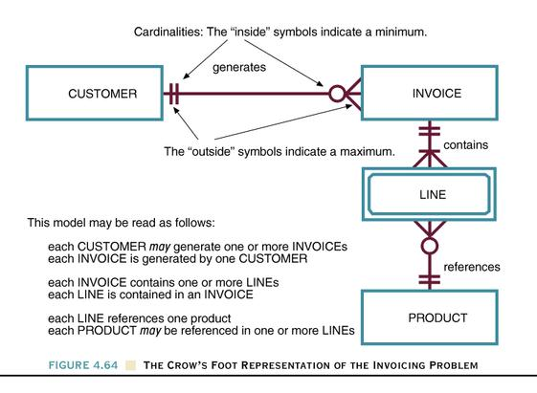
The Crow’s Foot Representation of the Invoicing Problem
Figure 4.64

Slide 17
E-R Model
Roles in Relationships
The way an entity is involved in a relationship is called the role of the entity in the relationship. These details provide more semantics of the database.
The role is generally clear from the relationship, but in some cases it is necessary to mention the role explicitly.
Two situations to mention the role explicitly are:
Recursive or Self-Referencing Relationships
Multiple Relationships
There exists multiple relationships between the same pair of entities.
Notes:
Page 92 (Hoffer)

Slide 18
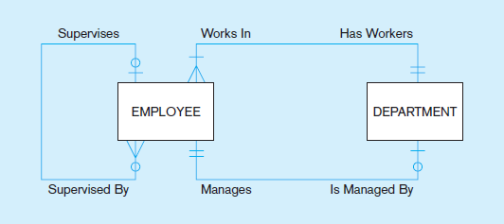
E-R Model
Roles in Relationships
Notes:
Page 92 (Hoffer)

Slide 19
E-R Model
Attribute(s) of Relationship
Along with entities of an ERD, a relationship can also have its attribute(s) called descriptive attribute(s).
The value of an attribute of a relationship jointly determined by the participants.
Grade

Slide 20
Strong
Weak Entity
Existence Dependency (Weak Entity)
An instance of one entity can’t exist without the existence of some other related entity.
An entity having an existence dependency is referred as Weak Entity (also called child, dependent, or subordinate entity) and it may optionally be represented by double rectangle.
An entity without an existence dependency is referred as Strong Entity (also called parent, owner, regular, or dominant entity).

Slide 21
Relationship Strength
a) Strong or Identifying Relationships
Weak entities often don’t have its own primary key, and it is unique only in reference to its relationship to its owner.
However, a weak entity has a partial key, also called a discriminator and the PK of the parent entity is used as part of the PK of the weak (child) entity.

Slide 22
E-R Model
Relationship Strength
b) Weak or Non-Identifying Relationships
It is a relationship between two regular entities, where primary keys of the related entities are disjoint.

Slide 23
Weak Entity, Identifying Relationship
Empno
Ename
Dependent_Name
Date_of_Birth
EMPLOYEE
Has
ENTITY
DEPENDENT

Slide 24
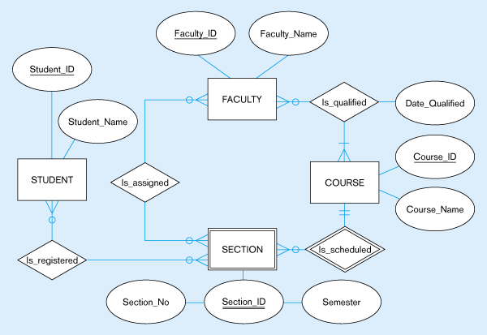
ERD segment for class scheduling

Slide 25
E-R Model
Degree of Relationship
It refers to the number of entities participating in a relationship.
There can be following types of relationships on the basis of degree:
a) Unary Relationship (relationship between the instances of a single entity type)
b) Binary Relationship (---- Two----)
c) Ternary Relationship (---- Three ----)

Slide 26
E-R Model
Degree of Relationship

Slide 27
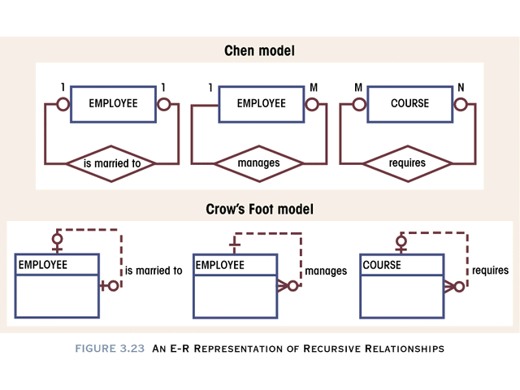
E-R Model
Recursive or Unary Relationship

Slide 28
Ternary Relationship

Slide 29
Ternary Relationship = Three Binary Relationships?
In general, a ternary relationship type represents different information than do three binary relationship types.
Let the instance of SUPPLIER, PRODUCT, and PROJECT entity types (last slide) are represented by s, p, and j respectively. The following diagram maintaining (s,p), (s,j), and (j,p) doesn’t necessarily imply an instance of (s,j,p) exists in a ternary relationship.

Slide 30
Ternary Relationship + Binary Relationships
A ternary relationship plus one or more of the binary relationships can be used in an ERD, if they represent different meanings and if all are needed by the application.

Slide 31
Weak Entity in a Ternary Relationship
Weak entity with several owners.
INTERVIEW has two owners (CANDIDATE and COMPANY).
ERD that keeps track of candidates interviewing for jobs at various companies. A candidate can have multiple interviews with the same company but a job offer is made based on one of the interviews.

Slide 32
Associative Entity
An associative entity is a many to many relationship that is represented as an entity type.
It is also called an entity in disguise or a Composite or Bridge Entity.
Associative entity is an entity derived from a relationship.
It is represented by and Enclosed diamond symbol within entity box
Examples (next slides)
Notes:
Attributes of a Relationship
Fig. 2-11 Page 79 (J. Hoffer 10th Ed.)
An attribute cannot be associated with a one-to-many relationship

Slide 33
Associative Entity

Slide 34
Associative Entity
Certificate_Number
Date_Completed
Course_ID
Emploee_ID
Employee_Name
EMPLOYEE
CERTIFICATE
COURSE
Course_Title
Topic
Birth_Date
Associative Entity

Slide 35
Associative Entity / Ternary Relationship

Slide 36
Converting Relationship to an Associative Entity
Conditions are:
All of the relationships for the participating entity types are “many” relationships
The resulting associative entity has independent meaning to end users, & preferably can be identified with a single-attribute identifier
The associative entity has one or more attributes in addition to the identifier
The associative entity participates in one or more relationships independent of the entities related in associated relationship

Slide 37
E-R Model
Modeling Repeating Groups
A repeating group is a set of two or more multivalued attributes that are logically related.
A repeating groups is converted to a separate entity, and a relationship is introduced between the new entity and the entity from which it is removed.
Examples
Emp (empno, ename, job, …, skill#*, skill-name*, s-level*)
Student (Regno, sname, …, c-code*, c-title*, c-grade*)
The idea behind introducing the new entity is that the new entity is of independent interest to the organization, rather than just an attribute of other entity types.

Slide 38
Modeling Time Variant Data
A time variant data is a data whose values change over time. For Example: Price of a Product
Product (P#, P-name, …, price)
Product (P#, P-name, …, price*, eff-date*,P#)
Each value of the attribute price is time stamped with its effective data.
A Time Stamp is a time value associated with any data value.
A time stamp is used when we need to maintain a history of data values that change over time.
Notes:
Attributes of a Relationship
Fig. 2-11 Page 79 (J. Hoffer 10th Ed.)
An attribute cannot be associated with a one-to-many relationship

Slide 39
ER Traps or Connection Traps
Following two problems or issues that may arise due to misinterpretation of the meaning of certain relationships.
Fan Traps:
A model represents a relationship between entity types, but the pathway between certain entity occurrences is ambiguous.
A fan trap may exist where two or more 1:* relationships fan out from the same entity.
Chasm Trap: A model suggests the existence of a relationship between entity
Notes:
Attributes of a Relationship
Fig. 2-11 Page 79 (J. Hoffer 10th Ed.)
An attribute cannot be associated with a one-to-many relationship

Slide 40
ER Traps – Fan Traps
Which members of staff work at a particular branch cannot be answered using ERD shown below.
The following ERD resolves the fan trap.
Notes:
Attributes of a Relationship
Fig. 2-11 Page 79 (J. Hoffer 10th Ed.)
An attribute cannot be associated with a one-to-many relationship

Slide 41
ER Traps – Chasm Traps
Which properties are available at each branch cannot be answered using ERD shown below.
The following ERD resolves the chasm trap.
Notes:
Attributes of a Relationship
Fig. 2-11 Page 79 (J. Hoffer 10th Ed.)
An attribute cannot be associated with a one-to-many relationship

Slide 42
Reading Material
Database Systems – Design, Implementation and Management: Carlos Coronel, Steven Morris (13th Ed.)
Modern Database Management: Jeffery. A. Hoffer (12th Ed.)
Database Systems: Thomas M. Connolly (6th Ed.)
Fundamentals of Database Systems: Elmasri (7th Ed.)
Database System Concepts: Abraham Silberschatz (7th Ed.)
Databases Illuminated: Catherine M. Ricardo (3rd Ed.)
Book | Section(s) / Chapter
A | 4.1, 4.2
B | Chapter 2 (Page 56 to 91)
C | 12.1, 12.2, to 12.4 to 12.6
D | Chapter 3
E | 6.1, 6.2, 6.4 to 6.6
F | 3.1, 3.2, 3.5 to 3.8

Slide 43
Thank you for your attention.
Asif Sohail
Assistant Professor
University of the Punjab
Punjab University College of Information Technology (PUCIT)
Allama Iqbal (Old) Campus, Anarkali
Lahore, Pakistan
Tel: +92-(0)42-111-923-923 Ext. 154
E-mail: asif@pucit.edu.pk

